Slide 1
Week 2
Modules: 1 and 2
Starting Berkeley Time
Topics:
Software as a Service, Agile Development, and Cloud Computing
Ruby Review

Slide 2
Software as a Service, Agile Development, and Cloud Computing

Slide 3
Plan & Document Software Development Process
General Idea
Before development, come up with a project plan, including an extensive, detailed documentation to improve predictability
Progress is measured against the plan
Documentation is necessary so that
New people can be onboarded
Information is not lost
Waterfall
3 types of P&D
Spiral
Rational Unified Process (RUP)
Notes:
Changes must be reflected whenever the goals change

Slide 4
Plan & Document Software Development Process
General Idea
Before development, come up with a project plan, including an extensive, detailed documentation to improve predictability
Progress is measured against the plan
Documentation is necessary so that
New people can be onboarded
Information is not lost
How did it come into existence?
Problem: Unplanned Software Development => Unpredictability
Waterfall
3 types of P&D
Spiral
Rational Unified Process (RUP)
Notes:
Changes must be reflected whenever the goals change

Slide 5
Plan & Document Software Development Process
General Idea
Before development, come up with a project plan, including an extensive, detailed documentation to improve predictability
Progress is measured against the plan
Documentation is necessary so that
New people can be onboarded
Information is not lost
How did it come into existence?
Problem: Unplanned Software Development => Unpredictability
Need: build software that was predictable in quality, cost & time
Inspiration from bridge construction in civil engineering
Waterfall
3 types of P&D
Spiral
Rational Unified Process (RUP)
Notes:
Changes must be reflected whenever the goals change

Slide 6
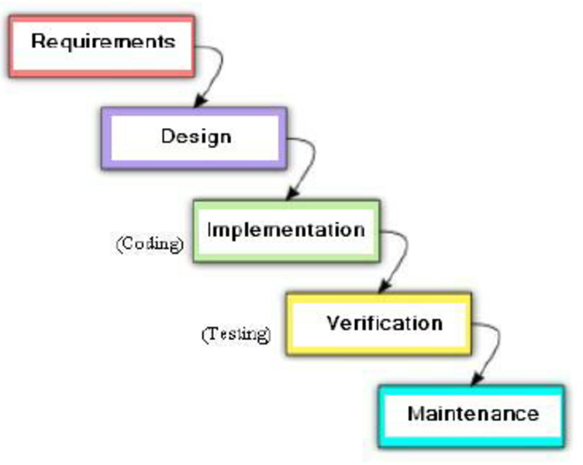
Plan & Document: Waterfall
General Idea: A top-down approach
Philosophy: complete a phase before going on to the next one (one-directional)
Rational
earlier you find an error the cheaper it is to fix
removing as many errors as early as possible
This prevents unnecessary work

Slide 7
Plan & Document: Waterfall
General Idea: A top-down approach
Philosophy: complete a phase before going on to the next one (one-directional)
Rational
earlier you find an error the cheaper it is to fix
removing as many errors as early as possible
This prevents unnecessary work
Problem
This strategy runs into a trouble when customers change their minds about what they want, especially if they do so later during the process

Slide 8
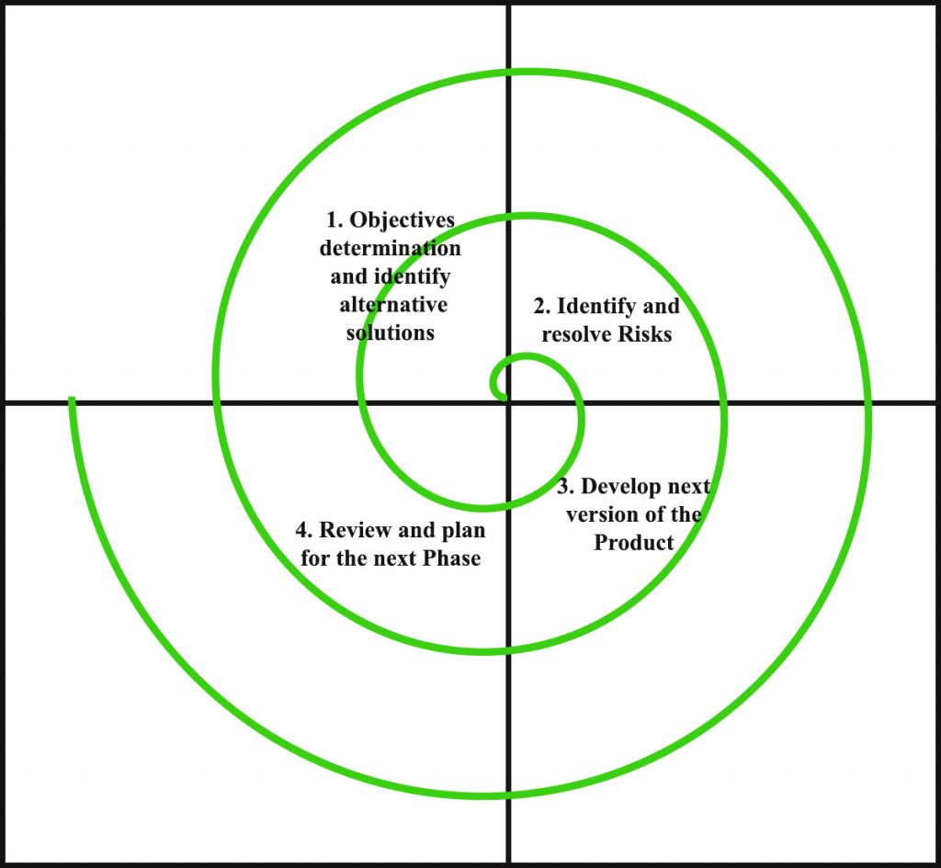
Plan & Document: Spiral
General Idea: Prototyping + Waterfall
The idea is to iterate through a sequence of four phases, with each iteration resulting in a prototype that is a refinement of the previous version.
4 phases
Determine objectives and constraints of this iteration
Evaluate alternatives; identify and resolve risks
Develop and verify the prototype for this iteration
Plan the next iteration
Advantage over Waterfall
??

Slide 9
Plan & Document: Spiral
General Idea: Prototyping + Waterfall
The idea is to iterate through a sequence of four phases, with each iteration resulting in a prototype that is a refinement of the previous version.
4 phases
Determine objectives and constraints of this iteration
Evaluate alternatives; identify and resolve risks
Develop and verify the prototype for this iteration
Plan the next iteration
Advantage over Waterfall
Easier for customers to understand what they want once they see the prototype

Slide 10
Plan & Document: Spiral
Pros
Risk Handling: The projects with many unknown risks that occur as the development proceeds, in that case, Spiral Model is the best development model to follow due to the risk analysis and risk handling during each iteration.
Good for large and complex projects.
Flexibility in Requirements: Changes at later phase can be incorporated accurately by using this model.

Slide 11
Plan & Document: Spiral
Pros
Risk Handling: The projects with many unknown risks that occur as the development proceeds, in that case, Spiral Model is the best development model to follow due to the risk analysis and risk handling at every phase.
Good for large and complex projects.
Flexibility in Requirements: Changes at later phase can be incorporated accurately by using this model.
Cons
Complex and Expensive: Spiral Model is not suitable for small projects as it is expensive.
Difficulty in time management: As the number of iteration is unknown at the start of the project, so time estimation is very difficult.

Slide 12
Plan & Document: Rational Unified Process
General Idea: Spiral + Waterfall + Documentation
4 phases (more dynamic)
Inception: business case, schedule and budget
Elaboration: identify use cases, design a software architecture, set the development plan, and builds an initial prototype.
Construction: code and test the product => first external release.
Transition: production, customer acceptance testing and user training
How is it different from Waterfall?
Each phase involves iteration
6 workflows / engineering disciplines (more static)
Business Modeling
Requirements
Analysis and Design
Implementation
Test
Deployment

Slide 13
Agile Software Development Process
General Idea
Incremental refinement of prototypes with continuous feedback from the customer over the course of many 14 week iterations.
Manage change, run compact projects with small teams, and deliver quality software on time and within budget.
Doesn’t create documentation but creates requirements as user stories as a result of frequent customer interaction
Daily standup meetings to identify and overcome obstacles
Often take a Kanban approach inspired by Toyota’s manufacturing process
4 principles (vs P&D)
Individuals and interactions over processes and tools
Working software over comprehensive documentation
Customer collaboration over contract negotiation
Responding to change over following a plan

Slide 14
Software Quality
General Idea
Ensures that products under development have high quality; Creation processes and standards in an organization that lead to high quality software
Must satisfy the needs of:
Customers: easy to use, doesn’t crash etc.
Developers: each to debug and enhance
Terminology
Verification: Did you build the thing right? Met specification?
Validation: Did you build the right thing? Build what the customer wants?

Slide 15
Software Quality
General Idea
Ensures that products under development have high quality and are creating processes and standards in an organization that lead to high quality software
Must satisfy the needs of:
Customers: easy to use, doesn’t crash etc.
Developers: each to debug and enhance
Terminology
Verification: Did you build the thing right? Met specification?
Validation: Did you build the right thing? Build what the customer wants?
Testing
Problem: Non-exhaustive nature of testing

Slide 16
Software Quality
General Idea
Ensures that products under development have high quality and are creating processes and standards in an organization that lead to high quality software
Must satisfy the needs of:
Customers: easy to use, doesn’t crash etc.
Developers: each to debug and enhance
Terminology
Verification: Did you build the thing right? Met specification?
Validation: Did you build the right thing? Build what the customer wants?
Testing
Problem: Non-exhaustive nature of testing
Solution: divide into unit testing, module testing, integration testing and system / acceptance testing; Alternatives: Formal Methods

Slide 17
Software Quality
General Idea
Ensures that products under development have high quality and are creating processes and standards in an organization that lead to high quality software
Must satisfy the needs of:
Customers: easy to use, doesn’t crash etc.
Developers: each to debug and enhance
Terminology
Verification: Did you build the thing right? Met specification?
Validation: Did you build the right thing? Build what the customer wants?
Testing
Problem: Non-exhaustive nature of testing
Solution: divide into unit testing, module testing, integration testing and system / acceptance testing; Alternatives: Formal Methods
Interesting example: Experiential Programming
Write tests before writing the code
Write minimum code to pass the test => code is always tested => low chances of writing code that will be discarded
Acceptance/System and Integration => BDD
Unit and module => TDD

Slide 18
Developer Productivity
Clarity via conciseness Small programs => Easy to evolve and understand => fewer bugs and easier to maintain How do programming languages do this? Syntax that lets programmers express ideas using fewer characters Raise level of abstraction

Slide 19
Developer Productivity
Clarity via conciseness Small programs => Easy to evolve and understand => fewer bugs and easier to maintain How do programming languages do this? Syntax that lets programmers express ideas using fewer characters Raise level of abstraction | Synthesis of Implementations Automatically generated code > Manually written code Metaprogramming: automatically synthesize code at runtime

Slide 20
Developer Productivity
Clarity via conciseness Small programs => Easy to evolve and understand => fewer bugs and easier to maintain How do programming languages do this? Syntax that lets programmers express ideas using fewer characters Raise level of abstraction | Synthesis of Implementations Automatically generated code > Manually written code Metaprogramming: automatically synthesize code at runtime
Reuse Reuse existing designs, procedures and functions > writing everything from scratch Object Oriented Programming => Inheritance Dynamic Typing Mix-ins Don’t have to change all copies when fixing a bug - just one place DRY - don’t repeat yourself

Slide 21
Developer Productivity
Clarity via conciseness Small programs => Easy to evolve and understand => fewer bugs and easier to maintain How do programming languages do this? Syntax that lets programmers express ideas using fewer characters Raise level of abstraction | Synthesis of Implementations Automatically generated code > Manually written code Metaprogramming: automatically synthesize code at runtime
Reuse Reuse existing designs, procedures and functions > writing everything from scratch Object Oriented Programming => Inheritance Dynamic Typing Mix-ins Don’t have to change all copies when fixing a bug - just one place DRY - don’t repeat yourself | Automation via tools Replace tedious manual tasks with tools to save time, improve accuracy, or both. Concerns Trade off between time to learn and time saved Dependability of the tool The quality of the user experience How to decide which one to use Examples Cucumber, Pivotal Tracker, RSpec, Compilers, Interpreters

Slide 22
SaaS
SaaS: Software as a service
Software is run on Internet based servers that communicate among each other and allow users to access the service via a web browser
Software as a Service (SaaS) is attractive to both customers and providers.
Customer: universal client (the Web browser) makes it easier for customers to use the service
Developer: single version of the software at a centralized site makes it easier for the provider to deliver, improve and frequent upgrade the service.
Advantages
??

Slide 23
SaaS
SaaS: Software as a service
Software is run on Internet based servers that communicate among each other and allow users to access the service via a web browser
Software as a Service (SaaS) is attractive to both customers and providers.
Customer: universal client (the Web browser) makes it easier for customers to use the service
Developer: single version of the software at a centralized site makes it easier for the provider to deliver, improve and frequent upgrade the service.
Advantages
No local installation removes hardware compatibility requirement
Service data is kept within service (no back up, data loss concerns)
Easier for groups of users to collaborate on same data
Centralized data with remote access that is good for large frequently changing data
Developers maintain single copy of server software (instead of 1 per OS)
Upgrades to software don’t interfere with user experience
Encourages more competition + better features among SaaS companies

Slide 24
SaaS and SOA
Problem
When creating SaaP, developers could make extensive use of software libraries containing code to perform certain tasks common to many applications. Using these third-party libraries embodies the advantage of software reuse.

Slide 25
SaaS and SOA
Problem
When creating SaaP, developers could make extensive use of software libraries containing code to perform certain tasks common to many applications. Using these third-party libraries embodies the advantage of software reuse.
Solution: Service oriented architecture
Service-oriented architecture (SOA) is a set of independent services composed together
A service is a program that can be communicated with APIs
SaaS service could call upon other services built and maintained by other developers for common tasks.
Services that were highly specialized to a narrow range of tasks are called microservices
Examples: credit card processing, search, driving directions etc..

Slide 26
SOA
Reusable: can combine existing services where each microservice is implemented with their own language/framework (implementation hidden behind API) | Performance: for each microservice, need to dig into the software stack of a network interface due to layers of APIs, which can cause performance penalty: State is split across services

Slide 27
SOA
Reusable: can combine existing services where each microservice is implemented with their own language/framework (implementation hidden behind API) | Performance: for each microservice, need to dig into the software stack of a network interface due to layers of APIs, which can cause performance penalty: State is split across services
Easy testing: each microservice does only one thing, testing that one thing in isolation is easier Allows developers to use best tool for job for each microservice | Dependability: Partial Failure is possible in SOA since microservices can fail independently from others, so it is not just a measure of “app is working” vs “app isn’t working”.In cases like this testing can be harder (integration and system tests, validation tests)

Slide 28
SOA
Reusable: can combine existing services where each microservice is implemented with their own language/framework (implementation hidden behind API) | Performance: for each microservice, need to dig into the software stack of a network interface due to layers of APIs, which can cause performance penalty: State is split across services
Easy testing: each microservice does only one thing, testing that one thing in isolation is easier Allows developers to use best tool for job for each microservice | Dependability: Partial Failure is possible in SOA since microservices can fail independently from others, so it is not just a measure of “app is working” vs “app isn’t working”.In cases like this testing can be harder (integration and system tests, validation tests)
Agile Friendly: works best with small-medium teams, since SOA allows small teams to develop microservices and then combining them. | Development Work: each microservice has to build their own interface instead of a single monster interface for the entire application, REST simplifies this each microservice essentially being end-to-end services that can stand on their own

Slide 29
SOA
Reusable: can combine existing services where each microservice is implemented with their own language/framework (implementation hidden behind API) | Performance: for each microservice, need to dig into the software stack of a network interface due to layers of APIs, which can cause performance penalty: State is split across services
Easy testing: each microservice does only one thing, testing that one thing in isolation is easier Allows developers to use best tool for job for each microservice | Dependability: Partial Failure is possible in SOA since microservices can fail independently from others, so it is not just a measure of “app is working” vs “app isn’t working”.In cases like this testing can be harder (integration and system tests, validation tests)
Agile Friendly: works best with small-medium teams, since SOA allows small teams to develop microservices and then combining them. | Development Work: each microservice has to build their own interface instead of a single monster interface for the entire application, REST simplifies this each microservice essentially being end-to-end services that can stand on their own
Same team is responsible for developing, testing and operating the microservice so customer-feedback cycles can be done quickly and efficiently | Dev/Ops: developers need to know about operations to be able to manage functionality and performance. If “you build you run” then you need to know ops deeper

Slide 30
Cloud Computing
Cloud computing provides a scalable and dependable hardware computation and storage for SaaS
Need of SaaS
Communication: allow any customer interact with the service
Scalability: central facility running the service must deal with the fluctuations in demand during the day and during popular times of the year for that service as well as a way for new services to add users rapidly.
Availability: both the service and the communication vehicle must be continuously available
How can these needs be fulfilled?

Slide 31
Cloud Computing
Cloud computing provides a scalable and dependable hardware computation and storage for SaaS
Need of SaaS
Communication: allow any customer interact with the service
Scalability: central facility running the service must deal with the fluctuations in demand during the day and during popular times of the year for that service as well as a way for new services to add users rapidly.
Availability: both the service and the communication vehicle must be continuously available
How can these needs be fulfilled?
Cluster: small scale computers connected by Ethernet switches > expensive large scale computer
More scalable than conventional servers: due to reliability on Ethernet switches
Virtual machine: software that imitates a real computer. An OS can be run on top of the VM abstraction
Can imitate with low overhead as well as simplify software distribution within a cluster
multiple apps can share hardware with each app believing that it has its own copy of the OS
OS-level virtualization: Docker

Slide 32
Cloud Computing
Cloud computing provides a scalable and dependable hardware computation and storage for SaaS
Need of SaaS
Communication: allow any customer interact with the service
Scalability: central facility running the service must deal with the fluctuations in demand during the day and during popular times of the year for that service as well as a way for new services to add users rapidly.
Availability: both the service and the communication vehicle must be continuously available
How can these needs be fulfilled?
Cluster: small scale computers connected by Ethernet switches > expensive large scale computer
More scalable than conventional servers: due to reliability on Ethernet switches
Virtual machine: software that imitates a real computer. An OS can be run on top of the VM abstraction
Can imitate with low overhead as well as simplify software distribution within a cluster
multiple apps can share hardware with each app believing that it has its own copy of the OS
OS-level virtualization: the apps are also able to share the operating system. Tool: Docker
Cheap: Clusters are 20x cheaper than expensive large scale computers
Dependability via extensive use of redundancy in hardware and software.

Slide 33
Public Cloud Services
General Idea
Public cloud services, utility computing, or often simply cloud computing offers computing, storage, and communication at pennies per hour
Economies of Scale
They take advantage of economies of scale
Many companies share large data centers
Smaller data centers often run at only 10% to 20% utilization.
These companies profit by offering there datacenter hardware on a pay-as-you-go basis
low-cost utility computing
Acquire resources immediately as your customer demand grows and releasing them immediately when it drops

Slide 34
Legacy Code
Successful software can live decades and is expected to evolve and improve
Terminology
Beautiful Code: long-lasting code that is easy to evolve.
Legacy Code: software that, despite its old age, continues to be used because it meets customers’ needs. However, its design or implementation may be outdated or poorly understood.
60% Maintenance Costs ⇒ Adding new functionality to legacy code
17% Maintenance Costs ⇒ Bug Fixing
Unexpectedly Short-lived Code: worst case, code that is soon discarded because it doesn’t meet customers’ needs.

Slide 35
Ruby Review

Slide 36
Ruby
Dynamically typed programming language
No need to declare a type => Like python
x = “hi there” #String
x = 3 #FixNum or Integer
x = 3.5 #Float
x = 3..10 #Range - inclusive
x = 3...10 #Range - exclusive
Object-oriented
Interpreted + Just-in-time compiler
snake_case variable names
Titlecase (or first letter is uppercase) for constants
Print statement equivalent => puts “hello world”
Comments
Single line: #
Multiline
=begin
...
=end

Slide 37
Ruby Objects
No primitive data types. Everything is an object
Common Data Types (Classes): Numbers, Strings, Ranges, nil (null in Java)
Uses "dot-notation" like Java objects for instance variables and methods
You can find the class of any variable
x = "hello" x.class → String
Different Classes of Numbers – FixNum, Float
3.eql?2 False
-42.abs 42
3.4.round 3
3.6.round 4
3.zero? False
Changing types of objects
to_i – converts to an integer (Fixnum)
to_f – converts a String to a Float
to_s – converts a number to a String

Slide 38
Ruby Arrays
Zero indexed. Negative index values can be used.
Uses square brackets, []
Elements are separated by commas
Store an assortment of types within the same array
a = [1, 4.3, "hello", 3..7]
You can assign values to an array at a particular index
Arrays increase in size if an index is specified out of bounds and fill gaps with nil
Example
a = [1, 4.3, "hello", 3..7]
a[4] = "goodbye"
a
> [1, 4.3, "hello", 3..7, "goodbye"]
a[6] = "hola"
a
> [1, 4.3, "hello", 3..7, "goodbye", nil, "hola"]
a[-1]
> “hola”

Slide 39
Ruby Conditionals
if age < 35
puts "young whipper-snapper"
elsif age < 105
puts "80 is the new 30!"
else
puts "wow..."
end
puts "young whipper-snapper" if age < 35 #inline
Unless is the logical opposite of if

Slide 40
Ruby Loops
array = [1, 2, 3, 4, 5]
while i < 5
puts i
i += 1
end
loop do
x += 1
break if x > 1
end
array.each do |x|
puts x
end
array.each { |x|
puts x
}
for x in array
puts x
end
4.times do
puts “hello world”
end
Cannot use "i++", "--i" but can use "i += 1", "i -= 1"
Until is the logical opposite of while

Slide 41
Ruby Methods
def method_name(parameter1, parameter2, ...)
statement
end
method_name(arg1, arg2)
def method_name(num1, num2, ...)
return num1 + num2
end
def method_name(num1, num2, ...)
num1 + num2
end

Slide 42
Ruby Blocks
Blocks of code that can be passes, called or yield
Defined by curly braces {} or do/end statement
{|v| puts v}
do |v|
puts v
end
(0..2).each {|v| puts v} => 012

Slide 43
Ruby Yield
yield statements goes hand-in-hand with blocks
The code of a block is executed when a yield statement is called
def yielding
puts "the program is executing the code inside the method"
yield
puts "now we are back in the method"
end
yielding { puts "the method has yielded to the block!" }
the program is executing the code inside the method
the method has yielded to the block!
now we are back in the method

Slide 44
Ruby Iterator
Collection-like objects like arrays and range have iterator methods
Iterator takes a block as callback and yield the block with each element in the collection
[1, 2, 3].each do |n|
text = "Current number is: #{n}"
puts text
End
Current number is: 1
Current number is: 2
Current number is: 3

Slide 45
Ruby Class
class Customer
$acquisition_cost = 0
@@cust_purchase_limit = 10
def initialize(id, name, addr)
@cust_id = id
@cust_name = name
@cust_addr = addr
end
def buy(product)
puts product
end
end
c1 = Customer.new(1, “Kyle”, “1234 Shattuck Avenue, Berkeley CA”)
c1.buy(“ball”) => “ball”
C1.name = “kyle”

Slide 46
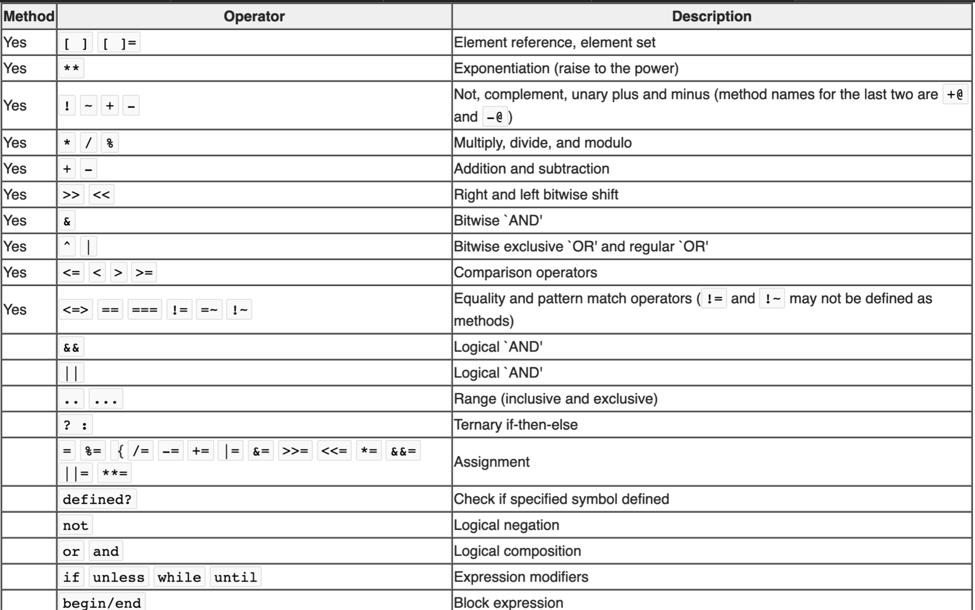
Ruby Operator Precedence

Slide 47
Attendance Form Link
https://tinyurl.com/discussion-quiz-1

Slide 48
Let’s Practice!

Slide 49
Quiz Practice #1
Which productivity mechanism does service-oriented architecture (SOA) best exemplify?
Clarity via Conciseness
Synthesis
Reuse
Automation via Tools
Notes:
SOA allows reuse at the level of entire services, which can be very productive. For example, by using Facebook Graph API, your app can reuse many of Facebook's social networking features.

Slide 50
Quiz Practice #1
Which productivity mechanism does service-oriented architecture (SOA) best exemplify?
Clarity via Conciseness
Synthesis
Reuse
Automation via Tools
Notes:
SOA allows reuse at the level of entire services, which can be very productive. For example, by using Facebook Graph API, your app can reuse many of Facebook's social networking features.

Slide 51
Quiz Practice #2
Which of the following functionality would most likely be defined as a class method?
return the total number of Movie objects created
update the ratings of a Movie object
compare and sort the actors of the Movie object in an alphabetical order
Notes:
a

Slide 52
Quiz Practice #2
Which of the following functionality would most likely be defined as a class method?
return the total number of Movie objects created
update the ratings of a Movie object
compare and sort the actors of the Movie object in an alphabetical order
Notes:
a

Slide 53
Quiz Practice #3
(Select all that apply.) Which statements comparing Plan-and-Document (P&D) with Agile software engineering processes are true?
The basic types of activities involved in software engineering are the same in P&D and Agile methodologies
Because Agile tends to focus on small teams, it cannot be used effectively to build large systems.
The Waterfall methodology involves the customer much more heavily at the beginning and end of the life cycle, whereas the XP (extreme programming) methodology involves the customer throughout the lifecycle.
The Spiral methodology combines elements of the waterfall model with intermediate prototypes.
Notes:
All but 2

Slide 54
Quiz Practice #3
(Select all that apply.) Which statements comparing Plan-and-Document (P&D) with Agile software engineering processes are true?
The basic types of activities involved in software engineering are the same in P&D and Agile methodologies
Because Agile tends to focus on small teams, it cannot be used effectively to build large systems.
The Waterfall methodology involves the customer much more heavily at the beginning and end of the life cycle, whereas the XP (extreme programming) methodology involves the customer throughout the lifecycle.
The Spiral methodology combines elements of the waterfall model with intermediate prototypes.
Notes:
All but 2

Slide 55
Quiz Practice #4
Internal data centers could get the same cost savings as Warehouse Scale Computers (WSCs) if they embraced SOA and purchased the same type of hardware.
True
False
Notes:
False: WSC has the cost advantage of economies of scale - 100,000 servers - difficult for internal data centers to meet

Slide 56
Quiz Practice #4
Internal data centers could get the same cost savings as Warehouse Scale Computers (WSCs) if they embraced SOA and purchased the same type of hardware.
True
False
Notes:
False: WSC has the cost advantage of economies of scale - 100,000 servers - difficult for internal data centers to meet

Slide 57
Quiz Practice #5
def boolean_potpourri
first = true and false
second = true && false
third = (true and false)
puts first, second, third
end
Determine what the following code snippet would print out:
true, true, false
true, false, false
false, SyntaxError (Unexpected Identifier)
false, false, false
Notes:
B because of operator precedence of = over and (look at precedence table)

Slide 58
Quiz Practice #5
def boolean_potpourri
first = true and false
second = true && false
third = (true and false)
puts first, second, third
end
Determine what the following code snippet would print out:
true, true, false
true, false, false
false, SyntaxError (Unexpected Identifier)
false, false, false
Notes:
B because of operator precedence of = over and (look at precedence table)

Slide 59
Quiz Practice #6 - Open ended
Create a situation where the following development processes must be used and give three reasons why it should be used.
Waterfall
Spiral
Rational Unified Process
Agile

Slide 60
More Quiz Practice
What are the differences between Agile and Waterfall?
Can you design and build hardware using the Agile Process?
What are some formal methods of verification and what are there pros and cons?
How does SaaS differ from traditional software? What makes it more advantageous?

